Slide 1
IBM AICTE PROJECT COLLEGE ADMISSION
Presented By:SUGHASHINI T
Student name : SUGHASHINI T
College Name & Department:UNIVERSITY COLLEGE OF ENGINEERING,VILLUPURAM&COMPUTER SCIENCE AND ENGINEERING.

Slide 2
OUTLINE
Problem Statement
Technology used
Wow factor
End users
Result
Conclusion
Git-hub Link
Future scope
IBM Certifications

Slide 3
Problem Statement
The traditional college admission process is overwhelming, with students often confused about eligibility, course selection, and deadlines.
Proposed Solution:
An AI-powered College Admission Agent using Retrieval-Augmented Generation (RAG), IBM Granite Foundation Models, and IBM Cloud Lite Services. It interacts with students in natural language and provides real-time, personalized guidance based on trusted institutional data.

Slide 4
Technology used
IBM Cloud Lite Services.
Retrieval-Augmented Generation (RAG).
Natural Language Processing.
IBM Granite Foundation Models.

Slide 5
IBM cloud services used
IBM Cloud Watsonx AI Studio.
IBM Cloud Watsonx AI Runtime.
IBM Cloud Agent Lab.
IBM Granite Foundation Model.

Slide 6
Wow factors
This agent provides 24/7 assistance to students with:
Instant access to accurate admission info.
Summarized policies, fees, and eligibility.
Personalized course recommendations.
Application guidance and deadline reminders.
Real-time updates from trusted sources.

Slide 7
End users
Prospective college students.
High school counsellors.
College admission offices.
Parents and guardians.

Slide 8
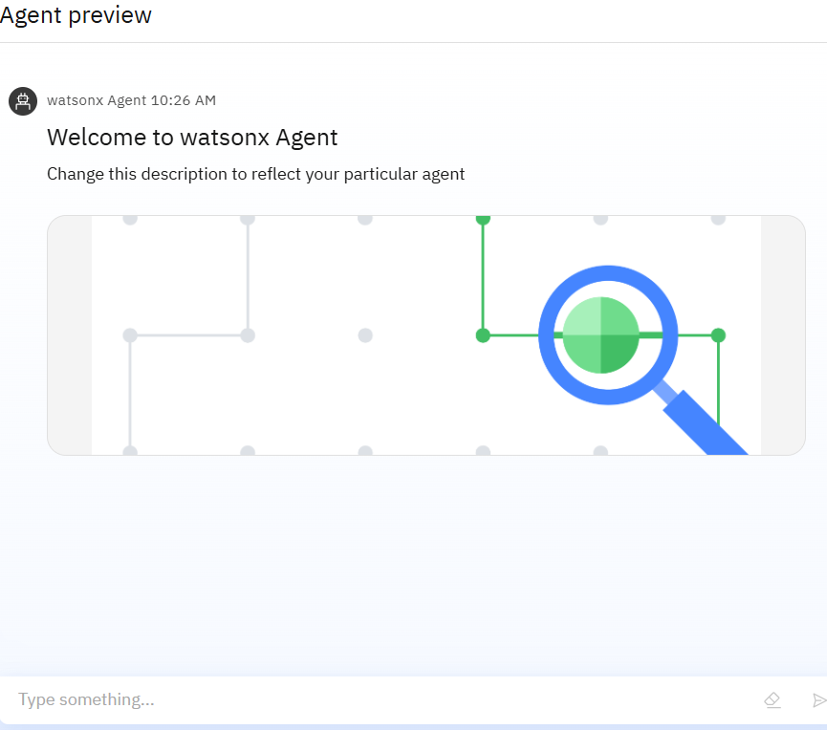
Results
Made the admission process simple and stress-free.
Gave students instant, accurate answers about courses, eligibility, and deadlines.

Slide 9
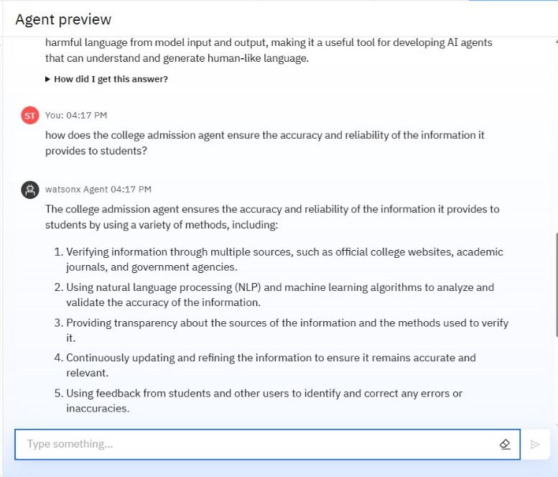
Results
Saved time for both students and admission staff.
Worked smoothly using trusted data and real-time responses.
Received positive feedback from students, parents, and counselors.

Slide 10
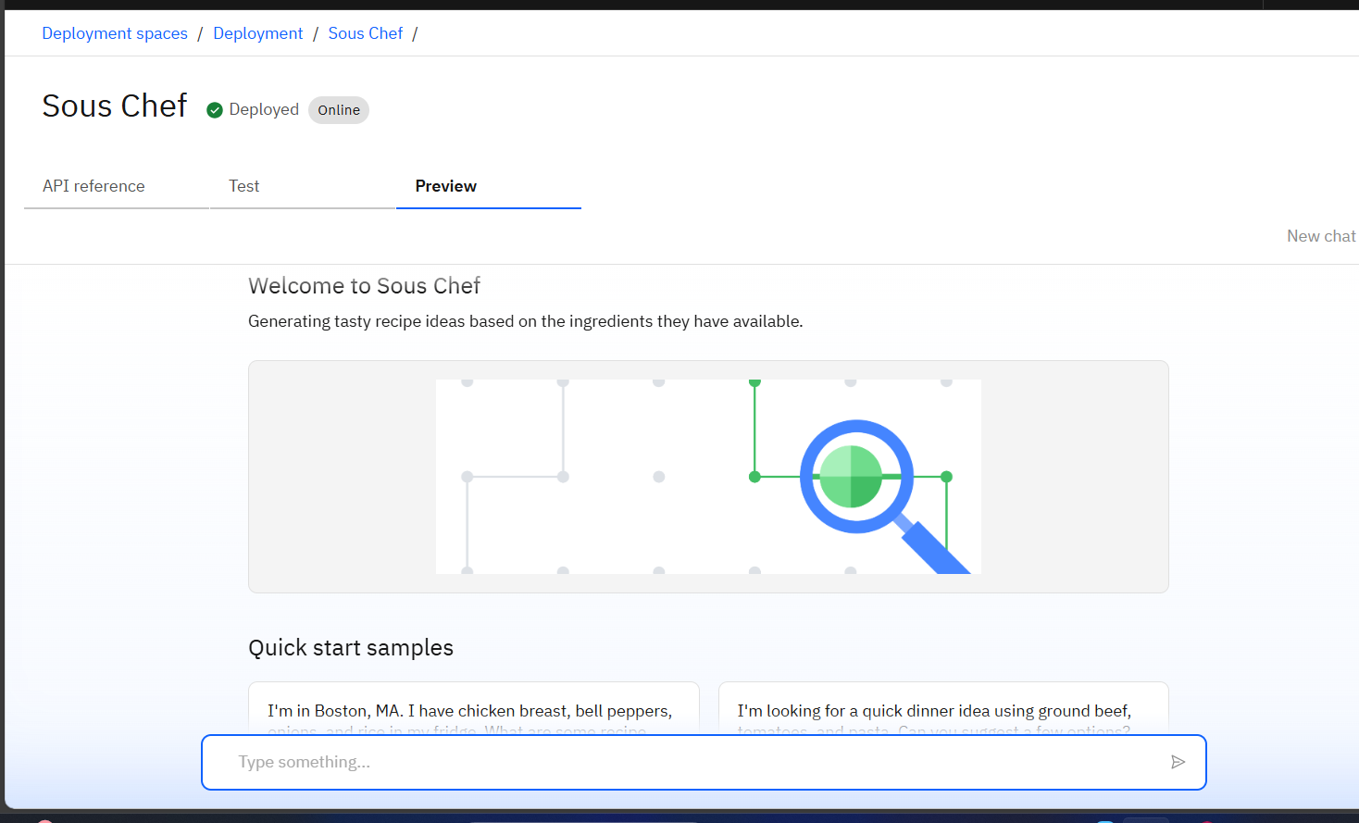
Results

Slide 11
Conclusion
The College Admission Agent simplifies the admission journey.
It empowers students with accurate, real-time information.
It improves transparency, reduces workload, and increases admission efficiency
Ideal for integration across educational institutions.

Slide 12
GitHub Link

Slide 13
Future scope
Voice interaction for accessibility.
Multilingual support.
Integration with national admission portals.
Chatbot UI for websites and mobile apps.
Data analytics dashboard for institutions.

Slide 14
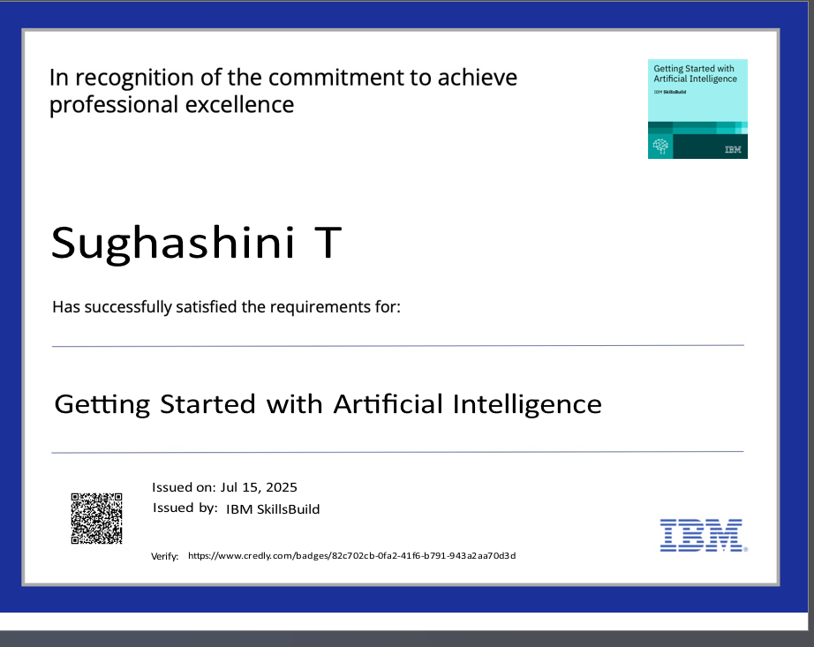
IBM Certifications

Slide 15
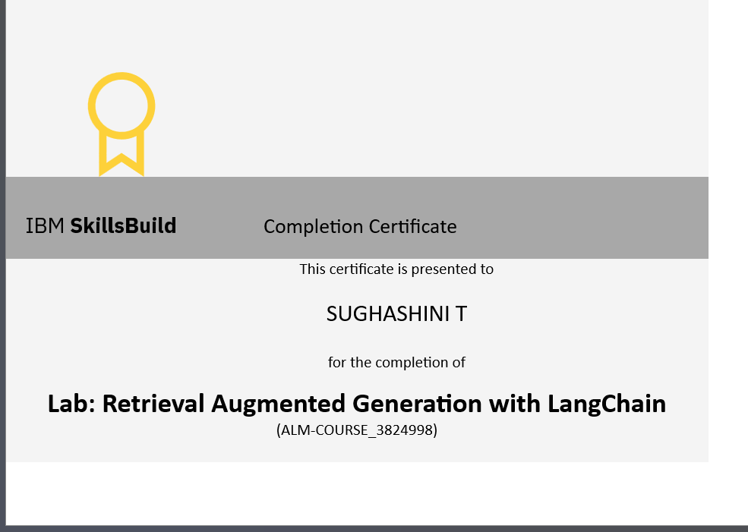
IBM Certifications

Slide 16
THANK YOU

